Slide 1


Slide 2
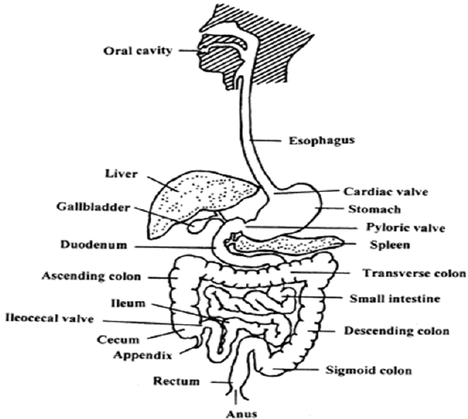
THE HUMAN DIGESTIVE SYSTEM

Slide 3
DIGESTION
It is the breakdown of food into small particles that can be absorbed and used by the body
It takes place in the alimentary canal

Slide 4
Parts of the digestive system

Slide 5
FUNCTIONS OF PARTS OF THE DIGESTIVE SYTSEM

Slide 6
MOUTH
It is where digestion of food begins
Food is broken down by the teeth into small particles that can be swallowed
Where food mixes with saliva, which is a digestive juice for carbohydrates
Digestion of starch takes place in the mouth
Tongue rolls the food and moves it to the oesophagus

Slide 7
OESOPHAGUS
Also called the gullet (passage of food)
Has muscles that push food downwards into stomach through peristalsis

Slide 8
STOMACH
Here food mixes with digestive juice called (gastric juice)
Food is broken down further
It produces hydrochloric acid which kills germs present in food
Digestion of proteins takes place in the stomach

Slide 9
SMALL INTESTINE (ILEUM)
The digestion of food is completed here
Food is then absorbed into the blood stream through finger like projections called villi
It has intestinal juice which completes the digestion of food

Slide 10
Large Intestines
Large intestines is also known as colons
From small intestines indigestible food passes into the large intestine
Water and mineral salts are absorbed into blood stream in the large intestines
Undigested food passes from the colon into rectum where it is stored for sometimes before released out through the anus
Indigestible foods (waste matter)are also called Faeces .it stays in the colon for sometimes before passed to the rectum
The process of getting rid of indigested food is known as egestion or defecation

Slide 11
Summary of the path taken by food
mouth
Oesophagus
Stomach
Small intestine
Large intestine
Anus

Slide 12
QUESTIONS

